Slide 1




EUROPEAN UNION
GOVERNMENT OF ROMANIA
Project co-financed by the European Regional Development Fund
Structural Instruments
2007-2013
Sectoral Operational Programme
„Increase of Economic Competitiveness”
“Investments for Your Future”
Extreme Light Infrastructure – Nuclear Physics (ELI-NP)
Quest for laser driven experiments at ELI-NP
Daniel Ursescu
19.06.2014, DFT Seminar, IFIN-HH

Slide 2
Content
Project outline
Main tools
Laser driven experiments
  TDR1: Laser driven nuclear physics
  TDR2: Strong field QED
  TDR3: combined laser gamma experiments
  TDR4: material science and applications

Slide 3
Content
Project outline
Main tools
Laser driven experiments
  TDR1: Laser driven nuclear physics
  TDR2: Strong field QED
  TDR3: combined laser gamma experiments
  TDR4: material science and applications

Slide 4
Extreme Light Infrastructure
2006 – ELI on ESFRI Roadmap
ELI-PP 2007-2010 (FP7)
  ELI-Beamlines (Czech Republic)
  ELI-Attoseconds (Hungary)
  ELI-Nuclear Physics (Romania)
ELI-DC (Delivery Consortium): 2010
Legal entity: April 2013
Czech Republic, Hungary, Romania, Italy, Germany, UK

Slide 5
ELI-NP Main Equipment
High power laser system, 2 x 10PW maximum power
Thales Optronique SA and SC Thales System Romania
Gamma beam, high intensity, up to 20MeV,
produced by Compton scattering of a laser beam
on a 700 MeV electron beam produced by a warm LINAC
EuroGammaS Association:
Instituto Nazionale di Fisica Nucleare (Italy)
Università degli Studi di Roma ”La Sapienza” (Italy),
Centre National de la Recherche Scientifique (France),
ALSYOM S.A.S. (France), ACP Systems S.A.S.U. (France),
COMEB Srl (Italy) ScandiNova Systems (Sweden), etc.

Slide 6

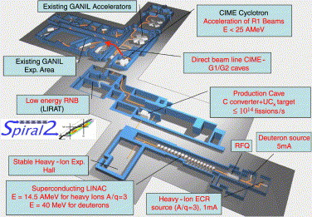
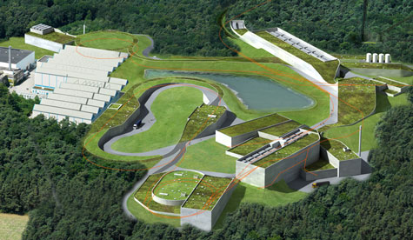
ELI–NP Nuclear Physics Research
Nuclear Physics experiments
Photo–fission & Exotic Nuclei
Nuclear Photonics (NRF)
Photo–nuclear reactions and structure
Nuclear Astrophysics
complementary to other ESFRI Large Scale Physics Facilities (FAIR, SPIRAL2)
Laser–Target interaction characteristics: NP diagnostics
Laser Ion driven nuclear physics experiments
Strong fields QED. Towards High field (Laser + Gamma) and Plasma
Applications based on HPLS and High intensity laser and very brilliant γ beams complementary to the other ELI pillars
ELI–NP in Romania selected by the most important science committees in Europe – ESFRI and NuPECC, in the ‘Nuclear Physics Long Range Plan in Europe’ as a major facility

Slide 7


ELI–NP Project Timeline
2010 2011 2012 2013 2014 2015
WB &Feasibility Study
Cost estimate 293M€
---TDR’s----------Cons
2016- 2018
2015-2017
Preparation of the Application
E.C. Eval. & Funding Approval
Civil engineering construction
Procurement Gamma Beam
Procurement Laser System
Experiments Instruments
Gamma Beam – installation
Laser System – installation

Slide 8
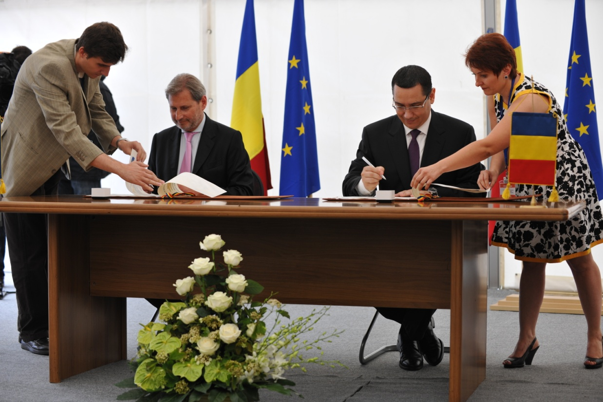
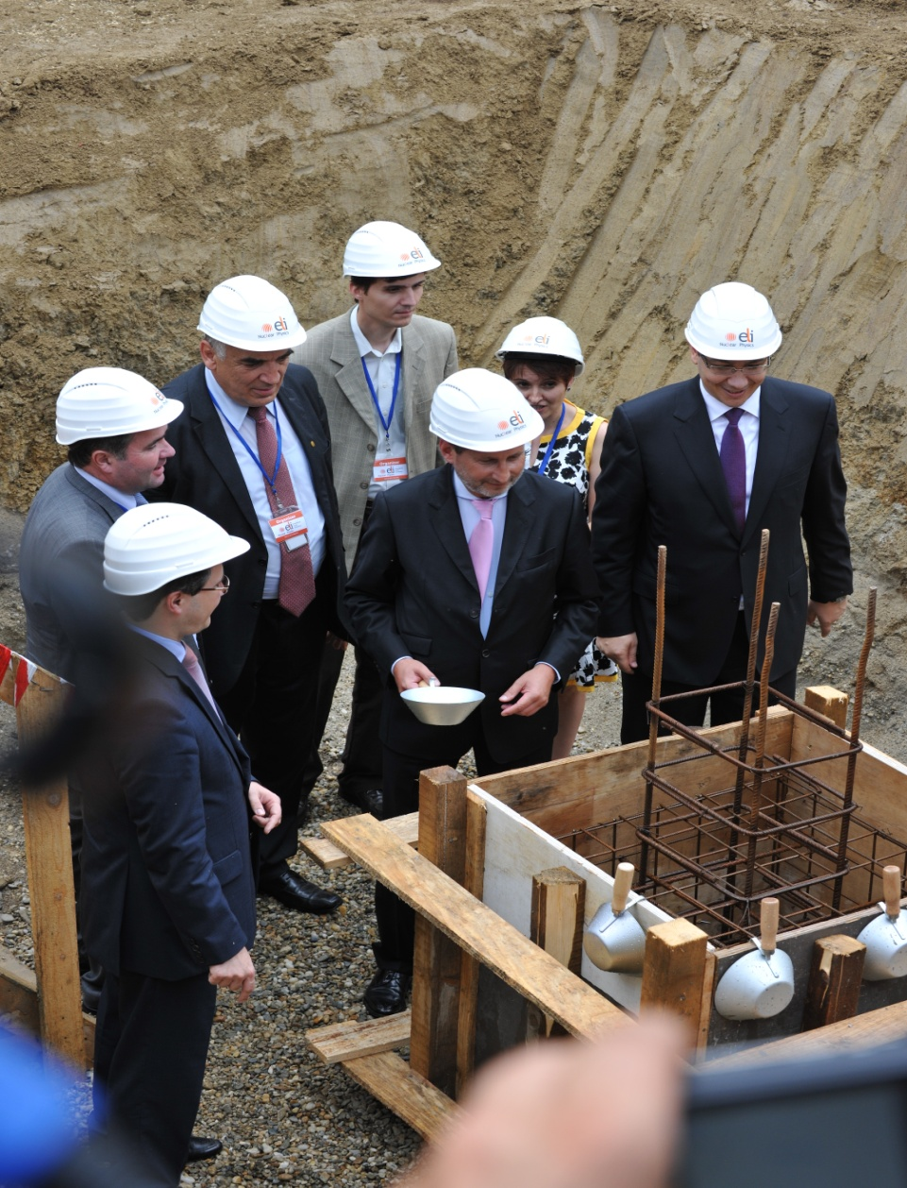
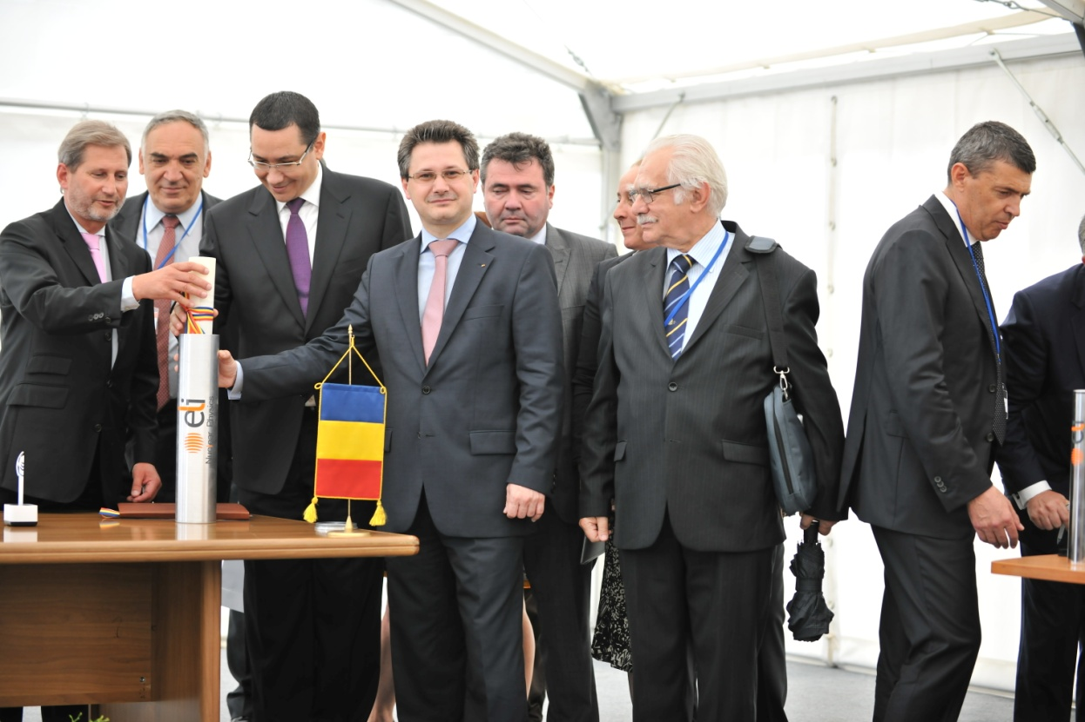
June 14th, 2013

Slide 9
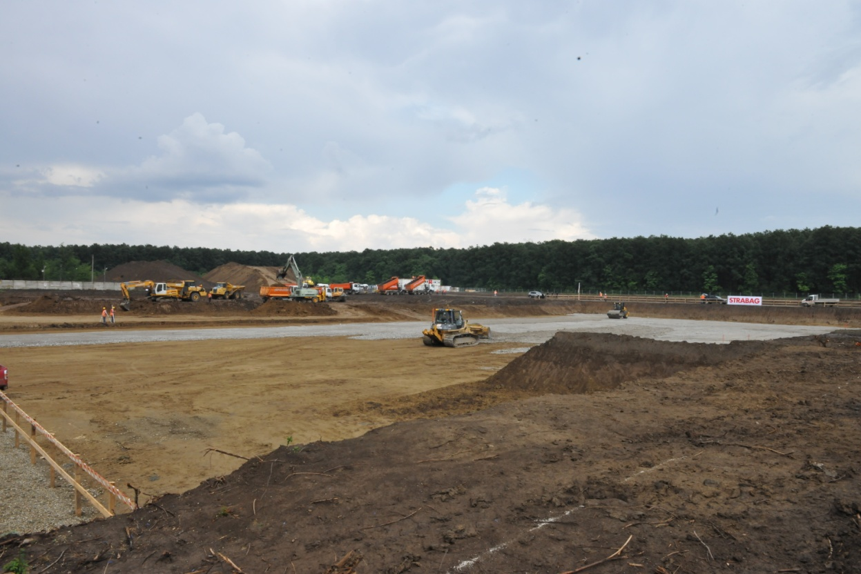
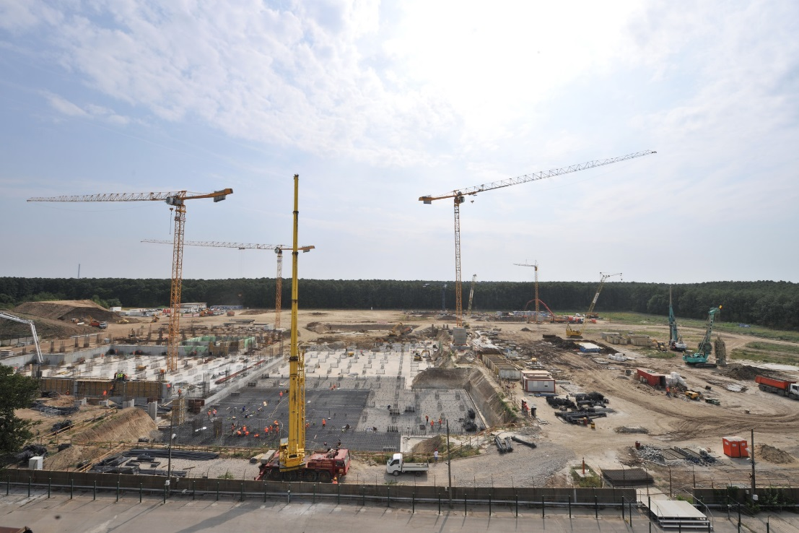
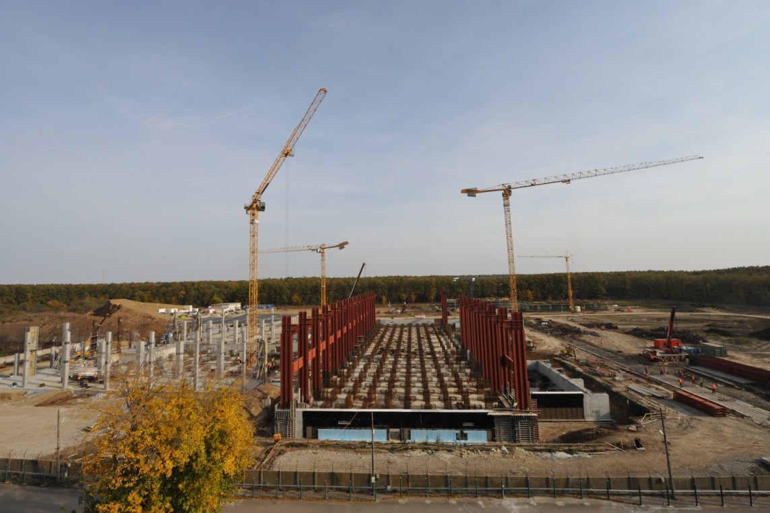
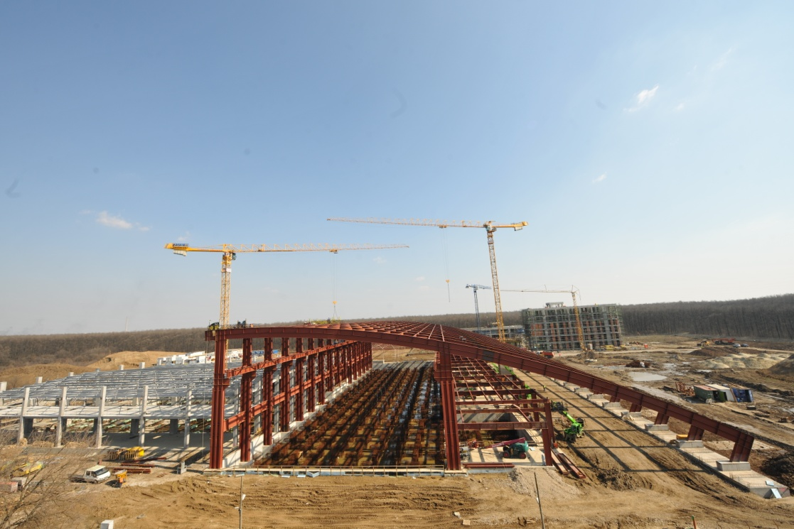
Building progress
June 14, 2013
August 23, 2013
October 31, 2013
March 13, 2014

Slide 10
Content
Project outline
Main tools
Laser driven experiments
  TDR1: Laser driven nuclear physics
  TDR2: Strong field QED
  TDR3: combined laser gamma experiments
  TDR4: material science and applications

Slide 11
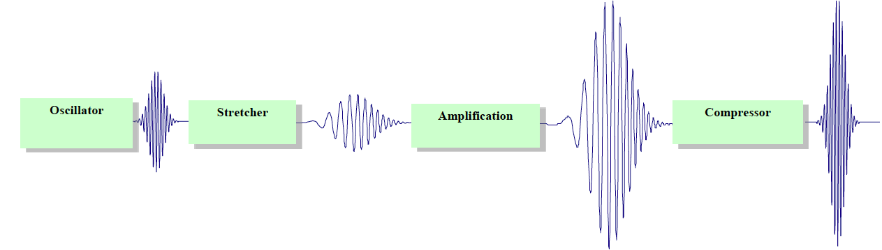
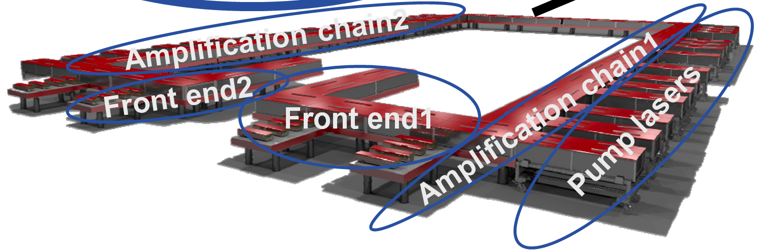
Provided by THALES - France
2 x 0.1 PW
2 x 1 PW
2 x 10 PW
Based on the principle of OPCPA
to compressors

Slide 12
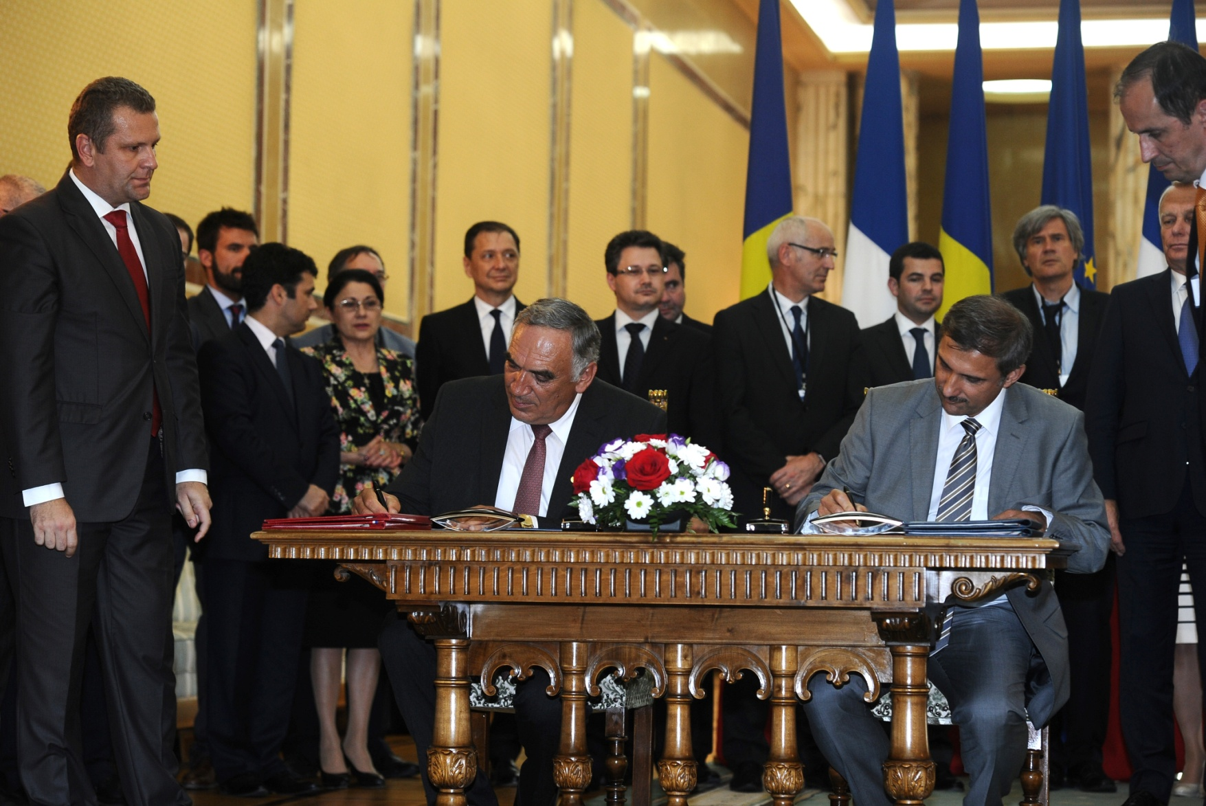
2x10PW Laser System
Thales Optronique SAS and S.C. Thales System Romania SRL
July 12th, 2013

Slide 13
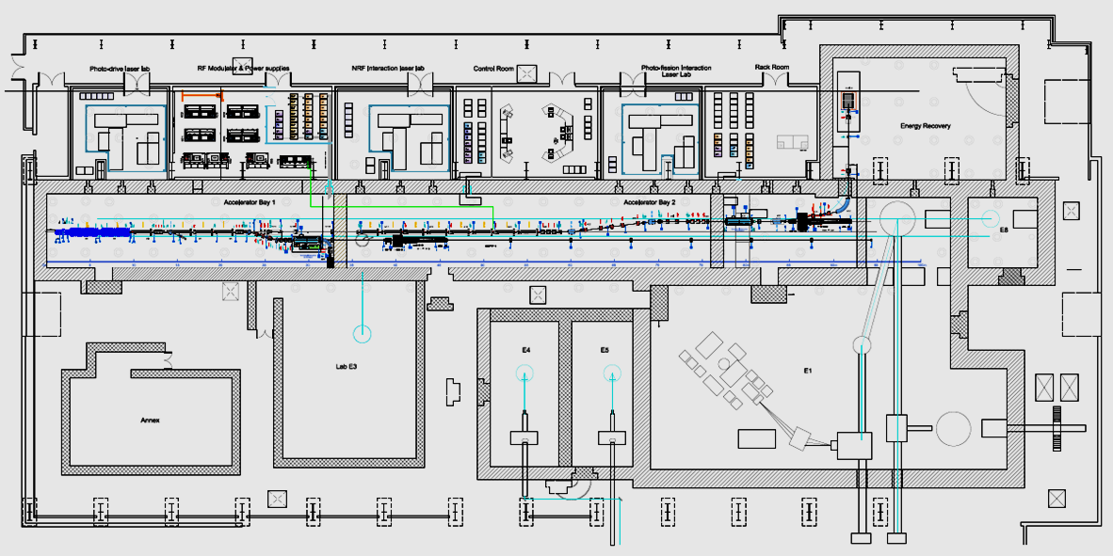
Lay –out of the Laser –Gamma Beam and experimental halls at ELI-NP

Slide 14
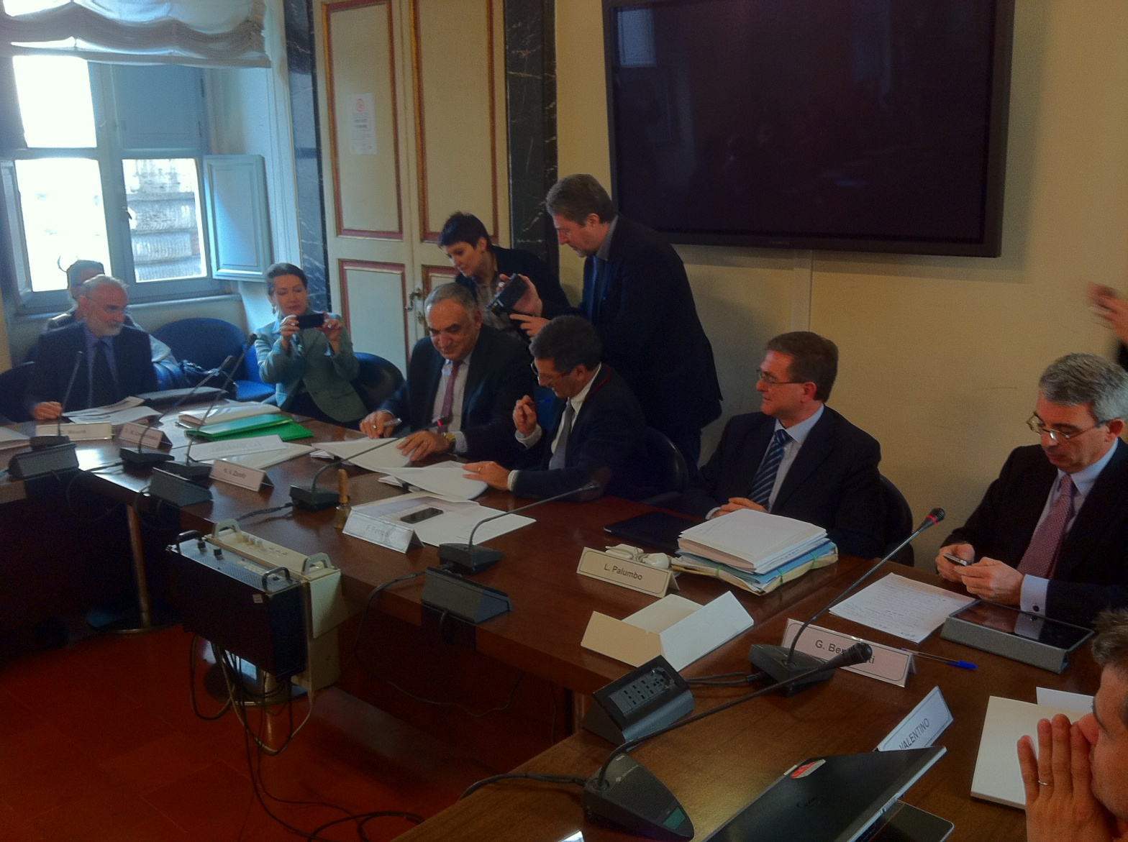
Gamma Beam System
EuroGammaS Association: Instituto Nazionale di Fisica Nucleare (Italy)
and Research Institutions and Companies from
Italy, France,
Sweden, UK,
Germany, Denmark,
Slovenia, Spain
March 19, 2014

Slide 15

ELI–NP Scientific Coordination
Scientific Director
International Workgroups for TDR’s
Gamma Beams System
High–Power Laser System
  Gamma Beam Delivery & Diagnostics
  NRF Experiments and applications
  Photo–fission experiments
  (γ,n) experiments
  (γ,p) experiments
  Applications, including (γ,e+)
  Convener local liaison
  Laser delivery and beam lines
  Laser Driven NP experiments
  Strong field QED
  Laser + Gamma interaction
  Applications
  Convener local liaison
Engineering bureau : Building Interface&Transversal Technical proposals
Safety RP Dosimetry, Vacuum, Control system
Alignments, Laboratories, Utilities

Slide 16
Content
Project outline
Main tools
Laser driven experiments
  TDR1: Laser driven nuclear physics
  TDR2: Strong field QED
  TDR3: combined laser gamma experiments
  TDR4: material science and applications

Slide 17
Main working groups
TDR Laser Beams Delivery: convener Gilles Cheriaux (LOA, France)
TDR1: Laser Driven Nuclear Physics – convener Markus Roth (TU Darmstadt, Germany)
TDR2: Strong Field QED – convener Paul McKenna, (SUPA, UK)
TDR3: Combined Laser-Gamma experiments – convener Kensuke Homma (Hiroshima University, Japan)
TDR4: Irradiated Materials Science – convener Marilena Tomut (GSI, Germany)
Vacuum related issues – M Toma, ELI-NP
Alignment related issues – Cristian Petcu, ELI-NP
Radioprotection related issues – Sorin Bercea, ELI-NP
EMP related issues – Marius Gugiu, ELI-NP
Control systems related issues – Mihail Cernaianu, ELI-NP

Slide 18
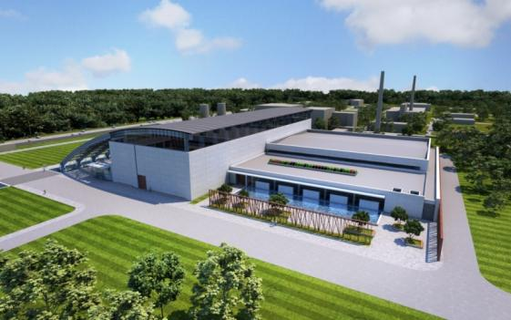
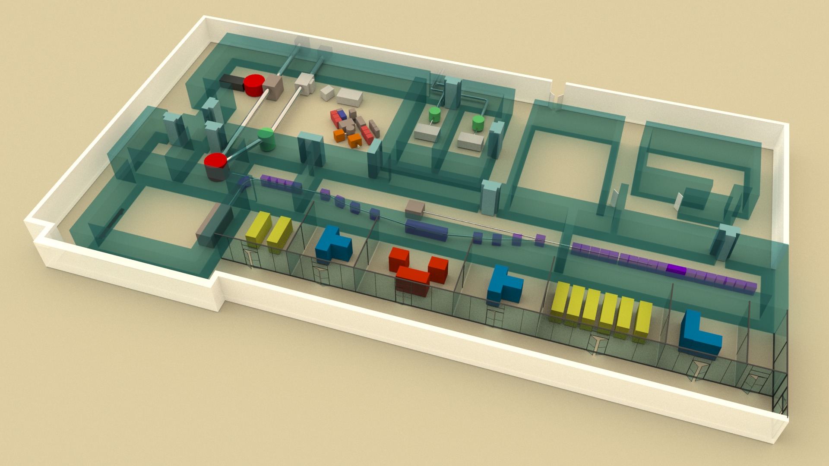
ELI–NP Experiment Building
HP Lasers
E6 10PW
E1 10PW
E5 1PW @ 1 Hz
E4 0.1PW @ 10 Hz
Experiments
8 experimental
areas
E7,2X10PW
E3 Positron
source
E8,Gamma
Nuclear reactions
E2,NRF
E7,QED High field
gamma + electrons
7000 m²

Slide 19
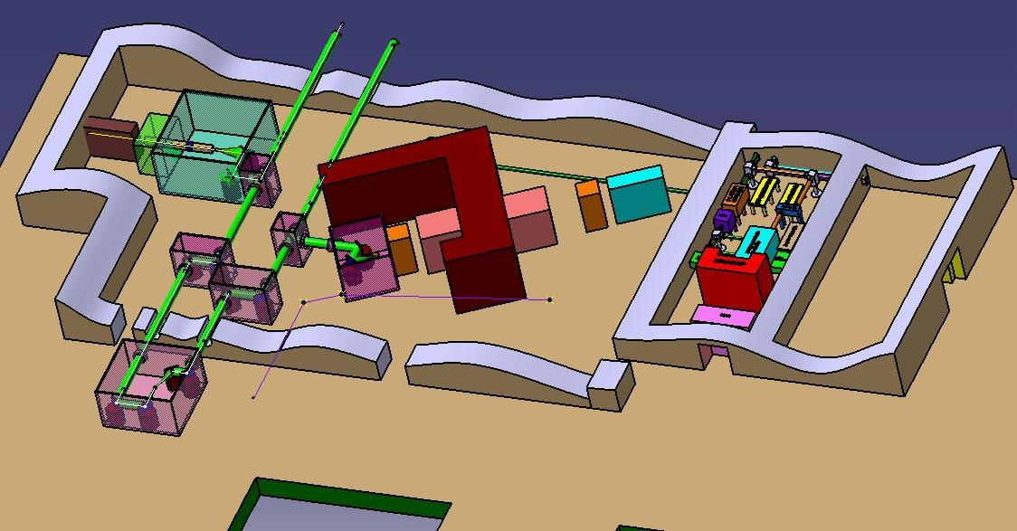
Preliminary , first step lay out of High Power Laser Experiments in
E1,E6,E5,E7
TDR1,TDR2, TDR3,TDR4
First generation of experiments to be implemented
Goals: Precise technical description , Target interaction chamber, Target technologies , vacuum, diagnostics and laboratories

Slide 20
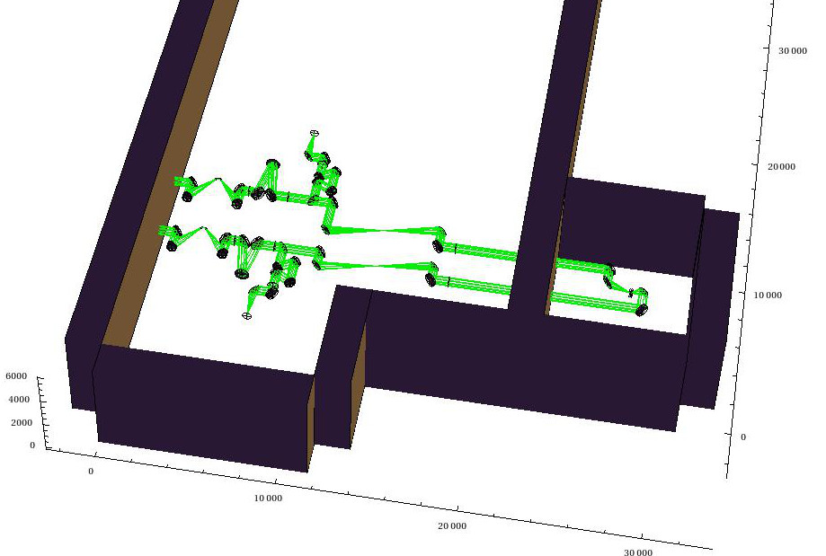
HPLS Delivery
Ion–driven NP
10 PW
Mirror
Adaptive optics
Polarization control
Relay imaging
E1
2x10PW
interaction area
E6
E7
Strong field QED
10 PW

Slide 21
Content
Project outline
Main tools
Laser driven experiments
  TDR1: Laser driven nuclear physics
  TDR2: Strong field QED
  TDR3: combined laser gamma experiments
  TDR4: material science and applications

Slide 22
Laser driven Nuclear Physics Experiments TDR1
Convener :M. Roth ELI-NP F. Negoita +WG members
2.1 Nuclear fusion reactions from laser-accelerated fissile ion beams
  2.1.1 RPA for heavy ions
  2.1.2 Stopping power of very dense ion bunches
  2.1.3 Fission-Fusion reaction mechanism
2.2 Nuclear (de)excitation induced by lasers
  26Al case
2.3 Nuclear Astrophysics in Laser plasmas
  2.3.1 13C(4He,n)16O and 7Li(d,n)4He-4He

Slide 23
The experiments for Laser Driven Nuclear Physics for E1 area at ELI-NP
Nuclear fusion reactions from laser-accelerated fissile ions, to understand the nucleosynthesis of heavy elements. The neutron rich nuclei (with N=126) produced in the laser induced fission and fusion reactions in a Thorium target, will make possible the study the production mechanism of heavy elements (through the r-process) . There is an experimental group to study:
Radiation Pressure Acceleration of heavy ions;
The Stopping Power for Intense Ion Bunches and
The fission – fusion reaction mechanism.
The Bethe –Bloch equation for the stopping power for the ion (eq. 1) has two terms: the binary collision term (T1) and the long range collective interaction term (T2). This allows the study of potential reduction of atomic stopping power or ultra dense ion bunches.
Laser Induced Nuclear (De)excitation, to study the excitation levels and lifetime of ²⁶Al.
Nuclear astrophysics in laser induced plasma, to study the nuclear reactions relevant in nucleosynthesis: ¹³C (⁴He, n) 16O ; ⁷Li (d, n) ⁴He ;

Slide 24
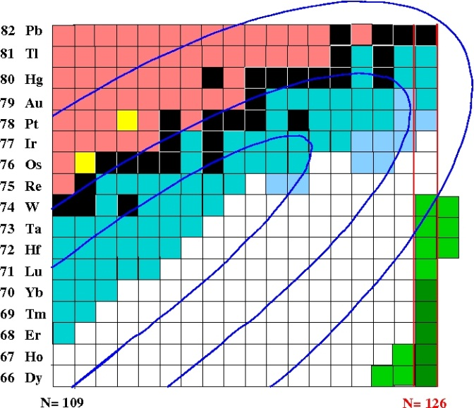
Laser Driven NP at ELI–NP
key
nuclei
15 neutrons away
from r process path (Z≈ 70))
Reaction target
²³²Th: ~ 50μm
Production target
Study of exotic nuclei of
astrophysical interest
produced using high
density ion bunches :
fission–fusion reactions.
n–rich nuclei around N = 126
waiting point
Study of heavy ions acceleration mechanism at laser intensities > 10²³ W/cm²
Deceleration of very dense electron and ion beams
Understanding influence of screening effect on stellar reaction rates using laser plasma
Nuclear techniques for characterization of laser–induced radiations
high-power, high-contrast laser:
300 J, ~30 fs (10 PW)
²³²Th: 560 nm
Fission
fragments
< 1 mm
~.10²³ W/cm²
Fusion products
focal diam. ~ 3 μm
CD₂: 520 nm
CH₂ ~ 70 μm
D.Habs, P.Thirolf et al., Appl. Phys. B 103, 471 (2011)

Slide 25
The scheme for fission-fusion experiments
The experiment proposed with 8.5 -17 PW laser beam (150-300 J), ultra-short pulses (32 femto-seconds). For a focal diameter of 3 micrometers, the Laser power was 1.2 ·10²³ W/cm².
Fission:
Beam: H, C, ²³²Th
Target: C, ²³²Th
²³²Th, 50 μm thick
²³²Th, 560 nm thick
1 mm
Fission fragments
Target like fission fragments:
Beam like fission fragments:
Fusion products
CD₂ 520 nm thick
Fusion from two light fission(target-like and beam –like) fragments
CH₂ 70 μm thick
D.Habs, P.Thirolf et al., Appl. Phys. B 103, 471 (2011)

Slide 26
Configurations possible with a 1PW and 10 PW laser beams (left fig) or two 10 PW laser beams.
1 PW of up to 250 J of compressed Laser beam
F/6
1PW
10 PW
F/3
F/3
10 PW
10 PW
F/3
10 PW

Slide 27
The required equipment in E1 area and the experimental challenges
Characterization of reaction products (decay spectroscopy)
Precision mass spectroscopy (Penning Trap or MR-TOF)
Challenges: Laser Acceleration of Heavy Species (RPA), the Optimization of target structure and shape, the repetition rate capability, the characterization of stopping range for Laser (with investigation of potential collective effects).
The development of the identification technique of the reaction products. : setup for precision mass measurements, wide acceptance separator for fission products, decay spectroscopy for short lived species.
The novel laser-ion acceleration (RPA) of the new species, allows the generation of ultra-dense ion pulses and the fission-fusion reaction mechanism.
The ELI-NP Laser will have 2 X 150 Joules/pulse, 30 femto-seconds /per pulse to get and intensity of I=10²³ W/cm²

Slide 28




Nuclear excitations with Ultra Intense lasers
M.M.Aléonard,
F.Hannachi, F.Gobet, M.Gerbaux, C.Plaisir, M.Tarisien, J.N.Scheurer
I LP
Recherche

Slide 29
Some orders of magnitude
1- Time scales
Laser wave period for 1 eV (λ∼1µm) photons: T = 4.10⁻¹⁵ s = 4 fs
Pulse duration (LOA ) ΔT = 30 fs i.e. 80 % of the energy in 8 periods
Bohr orbital electron period τ= 4 10 ^{–17} Z⁻² s (Al: 0.02 fs; Ca:0.01fs)
2 - Electric field scales
Intra-nuclear electric field: F_{n} = 10¹⁹ V/cm
Binding electric field in hydrogenoid atom F_{e} = (Z³ /n²) 2.7 10⁹ V/cm
₁₃Al F_{e} ~ 6 10¹² V/cm ₂₀Ca F_{e} ~ 2 10¹³ V/cm
laser wave electric field as a function of the intensity: F_{l} = 13.7 I ^{0.5}
I(W/cm²) 10¹⁴ 10²⁰ 10²² 10²⁴ 10²⁶
F₁(V/cm) 10⁸ 10¹¹ 10¹² 10¹³ 10¹⁴

Slide 30
What kind of nuclear physics with plasma created with high-power lasers?
Warm and dense plasma
High electromagnetic fields: 10¹¹ V/cm, 1000 T
Free electrons
Bound electrons
Electrons, γ, protons with
high energy (keV – MeV)
Modification
of bound energy
and nucleus – electron
couplings
Nuclear excitation and reaction yields in plasmas?
Nuclear Excitation by Electronic Capture (NEEC) in plasmas?
Modification
of nuclear deexcitation processes in plasma?
(Internal Conversion)

Slide 31






Nuclear Reactions in Plasmas
Nuclear Astrophysics
ELI-NP Meeting Darmstadt March 24, 2014
S. Tudisco
Collaboration
-LNS

Slide 32
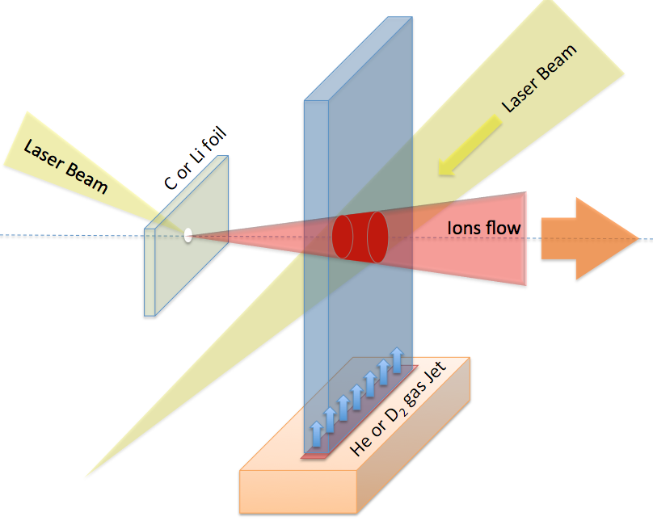
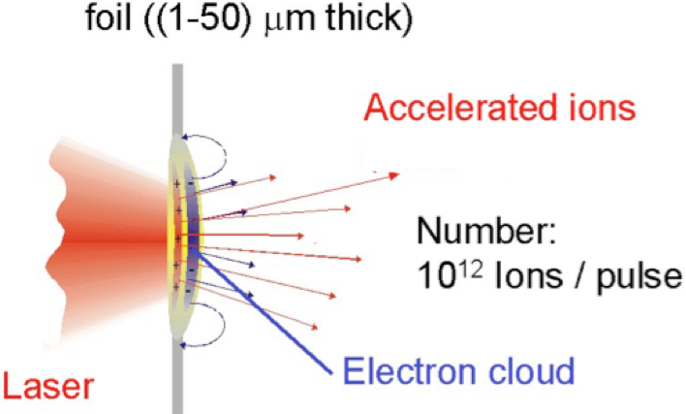
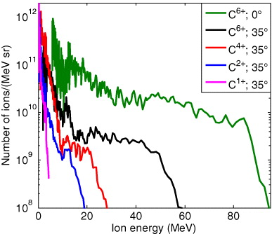
Methodology
Two laser beams generating two colliding plasmas
Secondary
Peta-Watts
Secondary Nd:YAG
Fixing TNSA regime
(an than the maximum ions energy)
the total ions number is determined by: Laser intensity, focal spot and target thickness
10¹⁸ Atoms/cm³
6×10²⁰ W/cm²
TNSA - Target Normal Sheath Acceleration 10¹⁸ - 10²⁰ W/cm²
Macchi et el. Rev of Mod. Phys, 85 (2013) 751
D.C. Carrol et al., New J. of Phys. 12 (2010) 045020

Slide 33
Content
Project outline
Main tools
Laser driven experiments
  TDR1: Laser driven nuclear physics
  TDR2: Strong field QED
  TDR3: combined laser gamma experiments
  TDR4: material science and applications

Slide 34
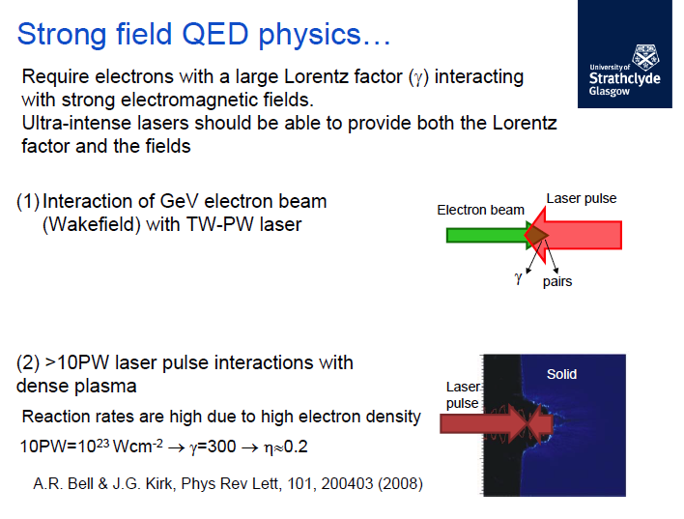
Strong Field QED
ELI–NP delivering pulse at > 10²³ W/cm² will enable
this exciting new regime to be investigated

Slide 35
High Field QED Experiments at ELI–NP
  High Field Physics in Beam-Beam Interactions
  Producing suitable secondary electron beams, gamma beams and controlling the laser pulses
  Nonlinear Compton Scattering
  Classical and Quantum kinetic radiation reaction effects
High Field Physics in Dense Plasma (Solid) Interactions
Intense synchrotron gamma-ray generation
Radiation reaction
Electron-positron pair production

Slide 36
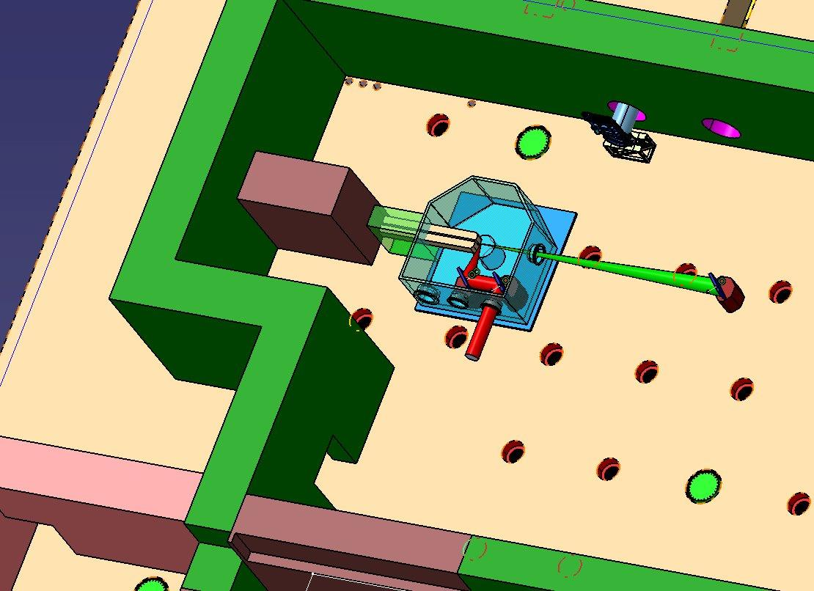
High Intensity Laser Fields and QED experiments at E6 area

Slide 37
High Field Physics with Beam-Beam interactions (E6
Laser beam with intensity >10²¹ W/cm² produces relativistic electrons in a gas plasma. The electrons are accelerated in the laser field. The work done by the Laser field a₀=eA/(mc²). Electrons gain a longitudinal momentum a₀². If a laser beam can be scattered off a counter propagating electron beam with ⋎>>1, to produce a gamma beam with shifted frequency by a factor 4·⋎² . The phenomena that can be studied are:
Classical Radiation Reaction, to understand how charged particles interact with their own radiation field. If a₀>>1 significant momentum is taken up by the electron oscillating in Laser Field and the radiation force is large. The Radiation Reaction can be treated as perturbation [1] or with a non-perturbative approach [2].
Nonlinear Compton Scattering is seen in low intensity laser beam 1< a0 < 10 and not-focused laser beam pulses to extend the interaction time and treat the laser as plane waves. Electron bunches (10 MeV) interacting head on with such laser beam, emit radiation with an intensity that depends on the mass shift of the electrons.
Classical and quantum kinetic radiation effects. Radiation Reaction tends to reduce the energy spread of the electrons when 50 MeV electron bunch collides head-on with the laser pulse of a0 =10. Quantum effects become important for 1 GeV electrons collide with a laser with a0=70, such that the Radiation Reaction increases the spread of electrons. Both effects could be studied at ELI-NP.

Slide 38
High Field Physics with Beam-Beam Interaction
Non-linear optics in relativistic plasma. At high laser intensity the bounce frequency of electrons trapped in trapped ponderomotive force is bigger than plasma forces. Coherent scattering in plasma, can compress laser pulses and enhance the beam intensity, allows the control of the pulse duration, the focusing and the contrast enhancement.
Electron beam generation using Laser Plasma Wake Field Acceleration. In the first stage, at ELI-NP, an electron beam will be accelerated to 5-10 GeV in the 10 PW Laser field focused in a 1 meter long plasma cell (with density 10¹⁶ – 10¹⁷ cm⁻³). The electron beam will be suitable for radiation reaction studies.
Betatron gamma rays generation: The LWFA electrons can be used as a source of gamma radiation. Hard X rays emitted from femto-second laser-produced plasma and betatron X rays from LWFA electrons, were reported [1].

Slide 39
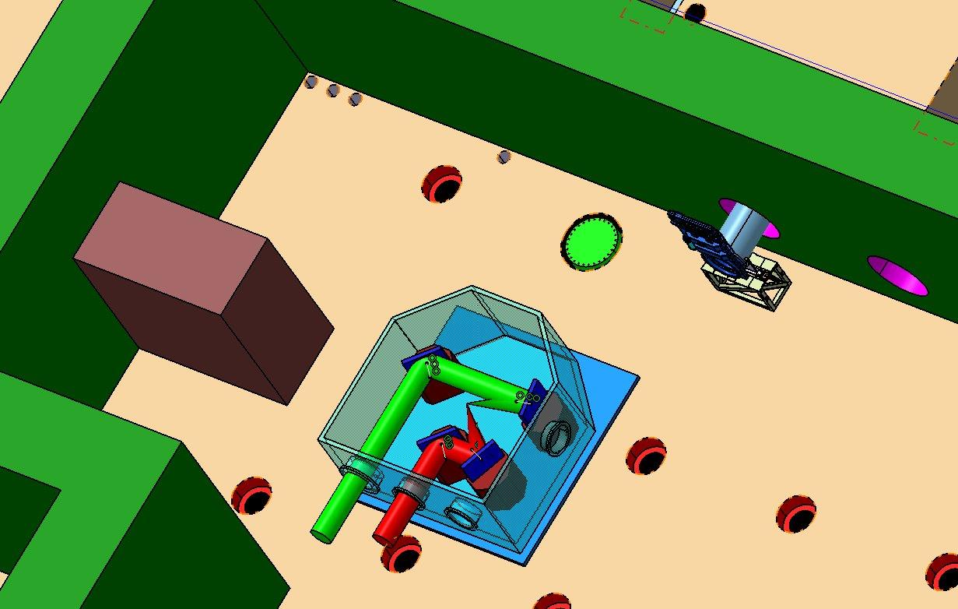
High Intensity Laser Fields and QED experiments at E6 area

Slide 40
High Field Physics with solid-laser interaction (for E6 area)
Two main QED processes are important in laser-solid interaction: a) Thomson scattering (e⁻+⋎_{L} ⇾ e⁻ + ⋎_{R} ) in which 40% of electron energy is damped in the Laser field, via synchrotron radiation emission. b) Pair production ⋎_{L} + ⋎_{R} ⇾ e⁻ + e⁺ . The two processes are important when the parameter η= γ/E (E_{p} +v x B), is almost unity. Here E_{p} is the perpendicular component of the electric field. The Lorentz factor γ >300 and η >0.2 and I=10²⁴ W/cm²
Intense synchrotron gamma rays produced from electrons accelerated by Laser’s electric field, when the damping force exceed the Lorentz force on electron. The ELI-NP laser beams with 10PW and 10²³ W/cm2 should enable the onset of radiation damping, when >35% of the Laser energy is converted to intense synchrotron radiation.
Electron –Positron pair production : a) an electrons with E>1.022 MeV produces electron-positron pair (the single stage Trident process) and b) electron emits a synchrotron radiation E>1.022 MeV that generates the electron – positron pair (the two stage Bethe Heitler process). A cascade of gamma rays and e-e pairs is predicted at laser intensities >10²⁴ W/cm².

Slide 41
Requirements for laser beam control and the characterization (at E6 area)
Highest possible intensity >10²³ W/cm²
Shot focal length F3 (or shorter) off-axis parabola mirrors.
Two 10 PW beams combined on target with coherent addition of the pulses, phase front tilt control
Polarization control needed, to switch from circular to linear polarization.
Ultra high intensity 10¹³:1 contrast is needed for nano-seconds pulses and 10¹⁴:1 at pico-seconds pulses.
Temporal shaping and control of rising edge of the laser pulse
Spatial shaping and control of focal spot distribution with adaptive optics.
Debris mitigation using suitable pellicles (with minimum front distortion) to cover the surface of the mirrors. Inter-changable optics required to minimize the downtime.

Slide 42
Laser diagnostics required for E6 area
Laser dignostics
Intensity temporal contrast measurements;
FROG Frequency Resolved Optical Gating Diagnostics.
Measurement of the laser focal spot energy distribution
The degree of the temporal overlap measurement
Synchronized optical probe to characterize the density gradient at target front surface
Near and far field monitoring of the laser beams
Electron beam diagnostics:
energy spectrometer,
beam profile,
charge (Faraday cup, ICT and calibrated),
emittance measurement,
beam transport system.
Plasma diagnostics for beam-beam experiments:
Thomson scattering
interferometer

Slide 43
Content
Project outline
Main tools
Laser driven experiments
  TDR1: Laser driven nuclear physics
  TDR2: Strong field QED
  TDR3: combined laser gamma experiments
  TDR4: material science and applications

Slide 44
TDR3 Combined laser - gamma experiments
Dark field search (Four-wave mixing in the vacuum)
QED birefringence studies
Electron induced nuclear processes investigated with gamma beams
Gamma-gamma scattering
Gamma assisted electron-positron pair production in vacuum; requires:
  Nonlinear Thomson scattering or
  X-ray laser / high order harmonics driven Backscattering gamma source
  Bremsstrahlung source driven by laser produced ultrarelativistic electron bunches

Slide 45
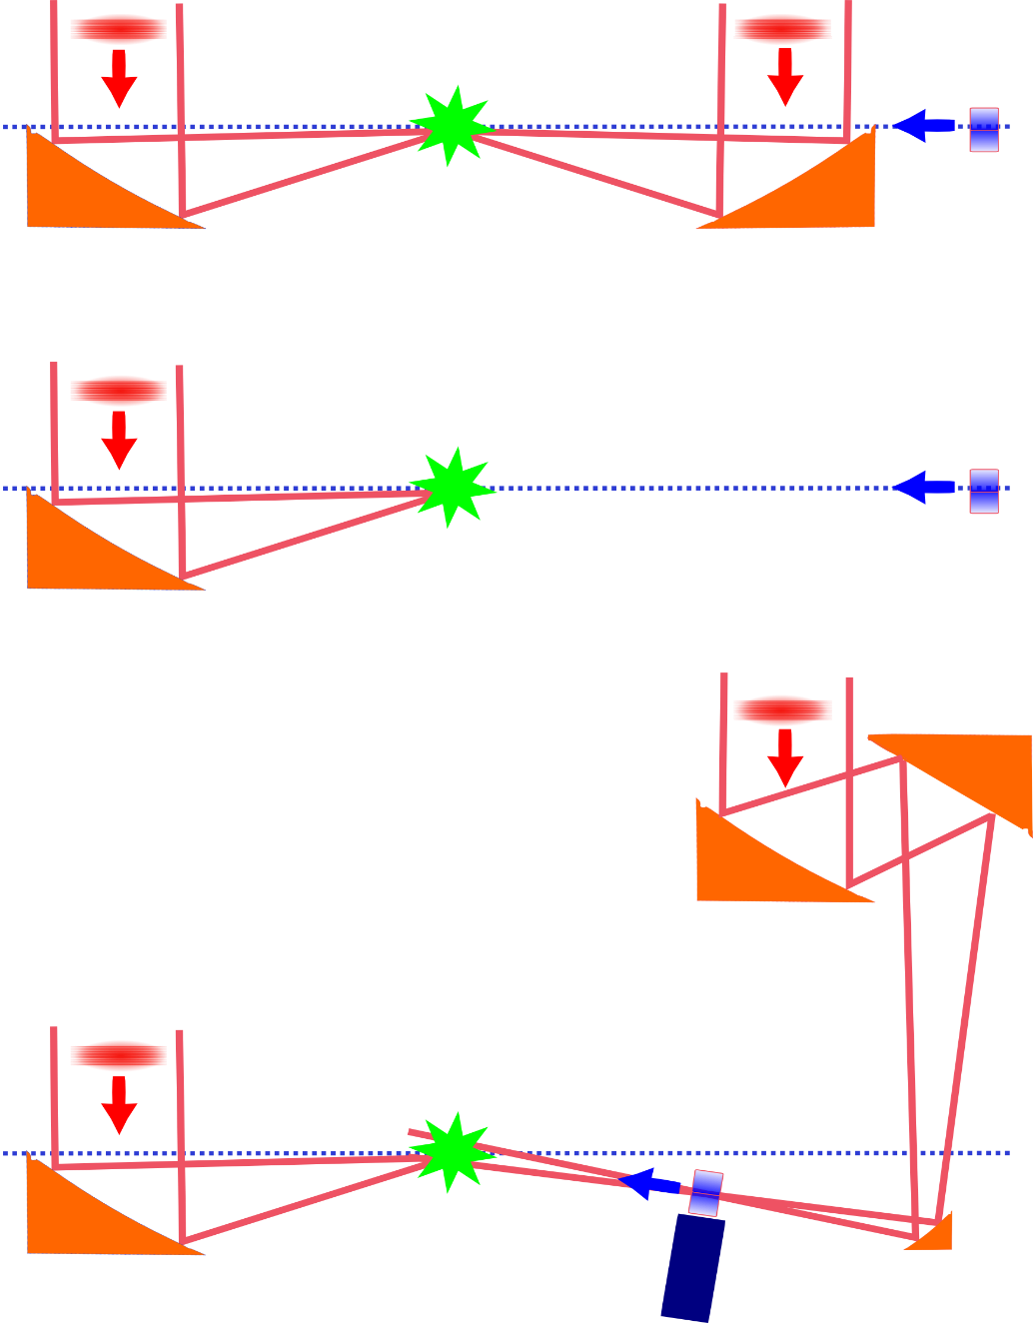
Experiments at E7
Laser pulse
Laser pulse
Combined laser-gamma
Experiments standard set-up
Interaction
point
e-/gamma from GBS
Focusing mirror
Combined laser-gamma
Nonlinear backscattering set-up
e- from GBS
Laser-only
Nonlinear backscattering set-up
e- from LWA
Gas jet
Plasma mirror
ELI-NP Workshop 2013 / K. Homma
Notes:
45
45

Slide 46
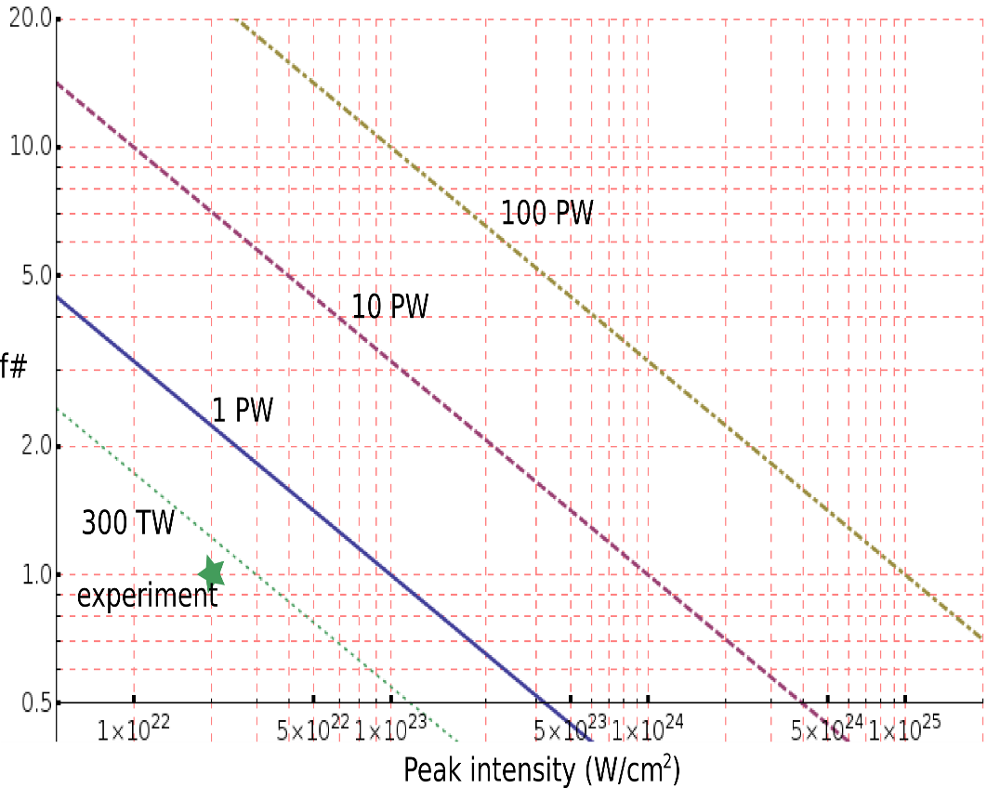
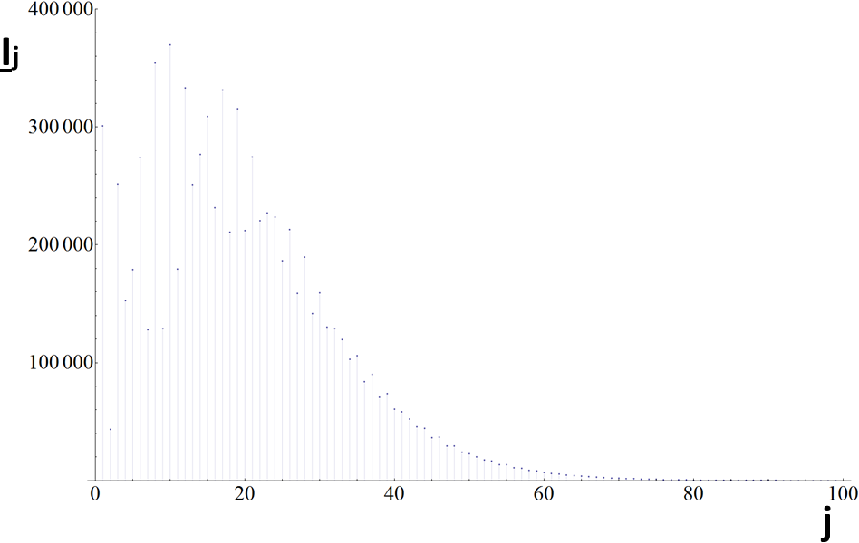
Experiments at E7: Nonlinear Scattering as extension method for the gamma range at ELI-NP
Harmonics in the gamma spectra to be seen
How to reach peak power
The spectrum of the normalized total scattered radiation for a=65.9. (I_{j} is the intensity of the j^{th} harmonic radiation).
Ionel, Ursescu, LPB2014
Focal distance correlation with the peak power in focus
Notes:
46

Slide 47
X-ray laser driven gamma source experiments proposal at ELI-NP
Banici,Ursescu et al, Optics Letters 2012:
X-ray laser driven with 200mJ pump energy @13.9 nm and 10Hz
Cojocaru, Ursescu et al, Optics Letters 2014
On-going Laserlab3 experiment for 200mJ pumped 100Hz X-ray laser @ MBI, Germany (D. Ursescu)
Available 100Hz laser for ELI-NP gamma facility with at least 200mJ energy/pulse
J. Rocca group, Optics Letters 2012:
Demonstrated 100Hz operation of an XRL driven with 1000mJ pump energy @13.9 nm and 10Hz
Notes:
47

Slide 48
Specific technologies
Target manipulation (gas target, solid target for bremsstrahlung generation)
Beam manipulation (plasma mirrors, mirror shifting)
Vacuum pipes
Vacuum pumping
Diagnostics of the beams at experimental areas (LBD?)
Detection and data processing
Beam dumps
Logistics

Slide 49
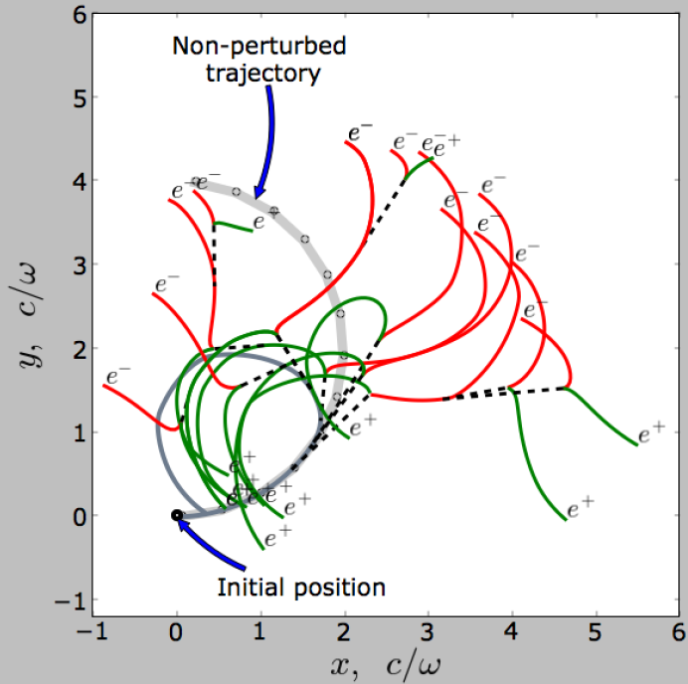
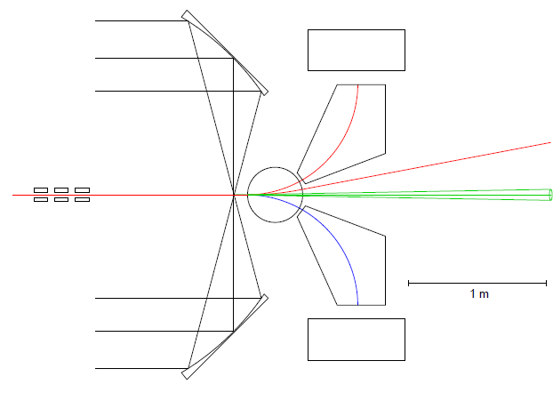
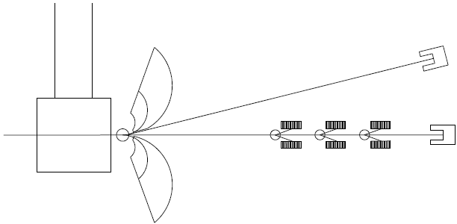
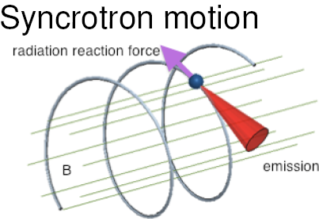
Laser-electron interaction
e-
600MeV e-
γ
e+
D. Habs et al.
arXiv:1010.4528 [hep-ph]
N. Elkina et al.
γ detectors
N. Elkina
D. Habs et al.
ELI-NP Workshop 2013 / K. Homma

Slide 50
TDR3: Electron induced nuclear processes investigated with gamma beams

Slide 51
Content
Project outline
Main tools
Laser driven experiments
  TDR1: Laser driven nuclear physics
  TDR2: Strong field QED
  TDR3: combined laser gamma experiments
  TDR4: material science and applications

Slide 52
TDR4: Applications of Material Science
• testing new materials for fusion and fission energy application
• testing of new materials for accelerator components
• testing materials for space science (electronics components,
hypervelocity impacts)
• surface and volume modification; micro- and nano-technology)
• biological science research (effects on bio-molecules, cells)
• testing radiation hardness and developments of detectors
• irradiated optical components testing
Potential partners: GSI, CERN, GANIL, Politecnico di Torino, ESA,
Fraunhofer-Institut für Kurzzeitdynamik Ernst-Mach-Institut EMI

Slide 53
Materials for Fusion Energy Systems
Extreme operating conditions on materials surrounding the plasma:
high heat fluxes
sputtering/redeposition
T₂ retention
Key strategies for the coming decade:
exploratory testing in prototypic fusion radiation environments (combined with modeling) to foster the development of candidate materials
Key issues in fusion materials degradation
Structural materials: dimensional stability and mechanical properties
Diagnostic materials: strong changes in electrical and optical properties
Key strategies for the coming decade :
new high density structural materials with nanoscale features conferring improved mechanical strength and radiation resistance

Slide 54
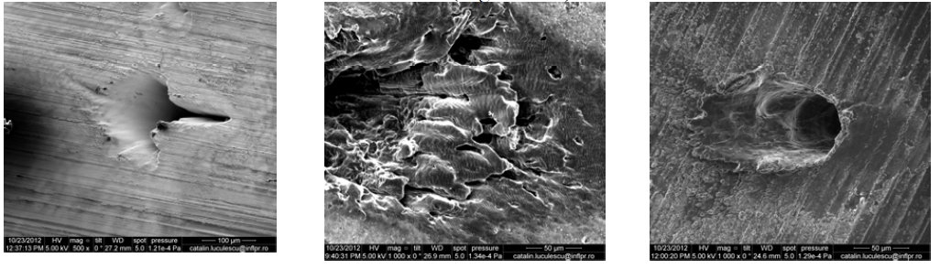
Laser irradiation studies for fusion reactor materials
SEM W probe SEM C probe SEM Be probe
Lungu, Ursescu et al, APL2014

Slide 55
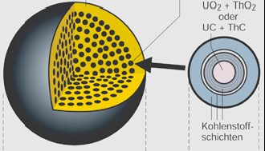
Materials for Fission Energy Systems
Very High Temperature Reactor Purpose:
More Efficient Power production
Inherent passive safety features
Breakthroughs needed
materials for extreme environments, high temperature, high radiation flux, high corrosivity

Slide 56
Testing of new materials for accelerator components
High power targets: production targets for radioactive beams, neutrinos, spallation targets
Potential collaborations: RADIATE, PASI
Secondary collimators for HL-LHC
-innovative materials are needed for accelerator collimator jaws for the upgrade of the LHC
-aims of collimator material experiments at ELI-NP: testing of novel materials under extreme conditions (accidental beam impact), quantifying of material damage for LHC operating scenarios
Notes:
56

Slide 57
Radiation-hard Space Electronics
• Due to its use on low‐Earth orbits, most consumer electronics is less tolerant to
radiation effects, as communication (commercial) satellites are exposed to far less
radiation than those placed on Geostationary orbits
• Sensors with increased ability used to gather satellite data
• Increased data traffic between satellites or back to Earth →need for more
powerful algorithms and more logic in a smaller space, as satellite costs have to be
“redimensioned “
• Power issues (solar cells), thermal issues and payload issues (processing large
amounts of data and making decisions or send data to the ground)
• Processing power has to be “adjusted” to data traffic while using as little power as
possible →shrinking of transistor size : 90 nm technology → worsening SNR
• Survival of 90 nm technology to aggressive space environment conditions
• Low voltages susceptible to radiation interference
• New technologies on the consumer market : wide‐bandgap technologies
• Radiation effects: total dose, constant bombardment of radiation and low dose
rate effects

Slide 58
Dynamic Response of Structural and Functional Space Materials to Micro-Meteoroid Impacts
Space environments are very hostile to many spacecraft materials and components due to the combined action of radiation, extreme temperature, and vacuum conditions, as well as impacting hypervelocity micro-particles:
Can be investigated using shock waves induced with flyers launched in high-power laser impacts on specially designed targets. These experiments can be performed both on pristine materials and on samples that have been exposed to increasing cocktail doses of particles, simulating the natural radiation exposure in space.
19 mm crater in the High-Gain
Antenna of the Hubble Space Telescope
Thousends of impacts on solar panels

Slide 59
Ground testing of space materials in extreme conditions
The radiation environment used for ground testing should ideally be similar to the natural environment probed by the satellite
This condition is difficult to achieve by traditional accelerator facilities
Cosmic radiation includes protons, helium and heavier ions, and also electrons, neutrons, and ultraviolet radiation. In this complex radiation environment many materials are damaged and deteriorate in a complex manner
The energy spectrum of laser accelerated particles is quite similar to the natural one (exponential energy distribution), unlike the quasi mono-energetic spectrum of accelerated particle beams in classical accelerators → develop rad hard testing procedures and standards
Vacuum and extreme temperatures as well as thermal cycling alter physical properties and lead to material fatigue.
Impacts of micro-meteoroids and orbiting man-made debris can damage spacecrafts and components.

Slide 60
Irradiated optical components testing
-characterization of optical components placed in the vicinity of laser driven
secondary radiation sources
-measuring the damage threshold modification at ISOTEST (INFLPR)

Slide 61
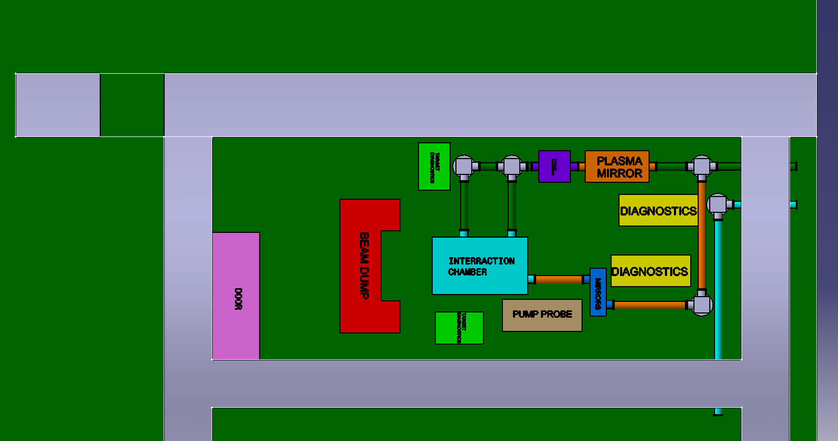
E5 experimental area (2x1PW@1Hz)

Slide 62
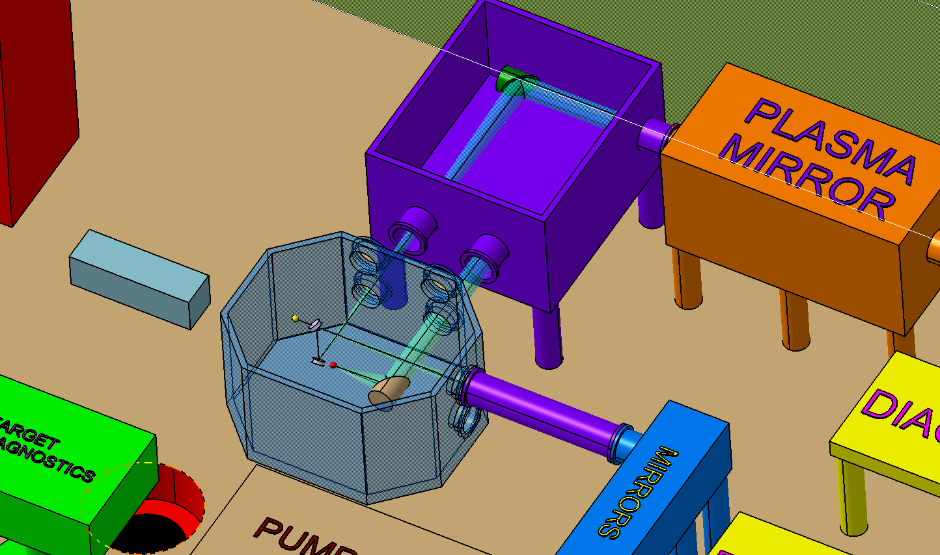
Layout E5

Slide 63
Following steps
TDRs to be completed between
Fall 2014 and Winter 2015
General workshop: Oct-Nov 2014
TDRs evaluated by independent reviewers March-May 2015
International Scientific Advisory Committee final endorsement of experiments in June 2015

Slide 64


Your collaboration is decisive and a must for ELI-NP
ELI-NP Team, March 5, 2013
Thank you!

